Slide 1
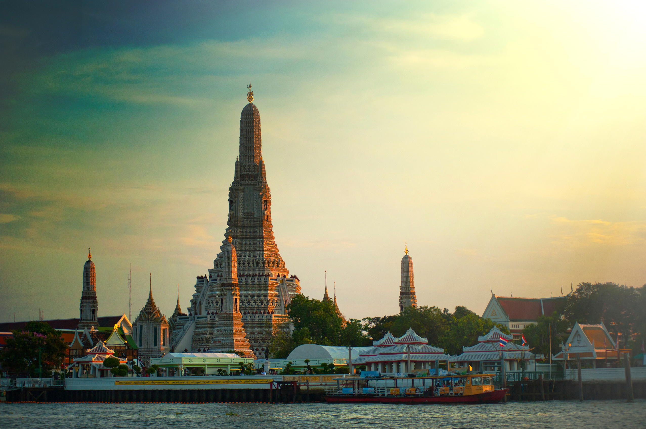
Mduduzi Malapane
Bangkok, Thailand
14-17 December 2024

Slide 2

Table of Contents
Entry/Exit Requirements
Etiquette and Cultural Expectations
Event Information
Budget
Travel Itenerary

Slide 3
Entry/Exit Requirements
Passport
Application form
Passport photographs
Itinerary
Air ticket
Copy of return air ticket
Accommodation
Minors
Source Link

Slide 4
Etiquette and Cultural Expectations
Dos and Don’ts in Thailand
Dos:
1. Respect the Wai: If unsure, a light bow or handshake is acceptable, especially for foreigners.
2. Stand for the National Anthem: Stop and remain still when it plays at 8 am and 6 pm.
3. Show respect for the King and Royal Family: Avoid criticizing them or damaging currency featuring the King's image.
4. Use the right hand: For eating, passing items, and greeting.
5. Remove shoes at temples: Slip-on shoes are convenient. Step over the threshold when entering.
6. Eat politely: Use a fork and spoon, eat from your bowl, and leave a little food to indicate you're full.
7. Summon waitstaff quietly: Wave with your palm down and say "nong" without snapping fingers or shouting.
8. Take photos respectfully: In temples, avoid flash and don't photograph worshippers or staff directly.

Slide 5
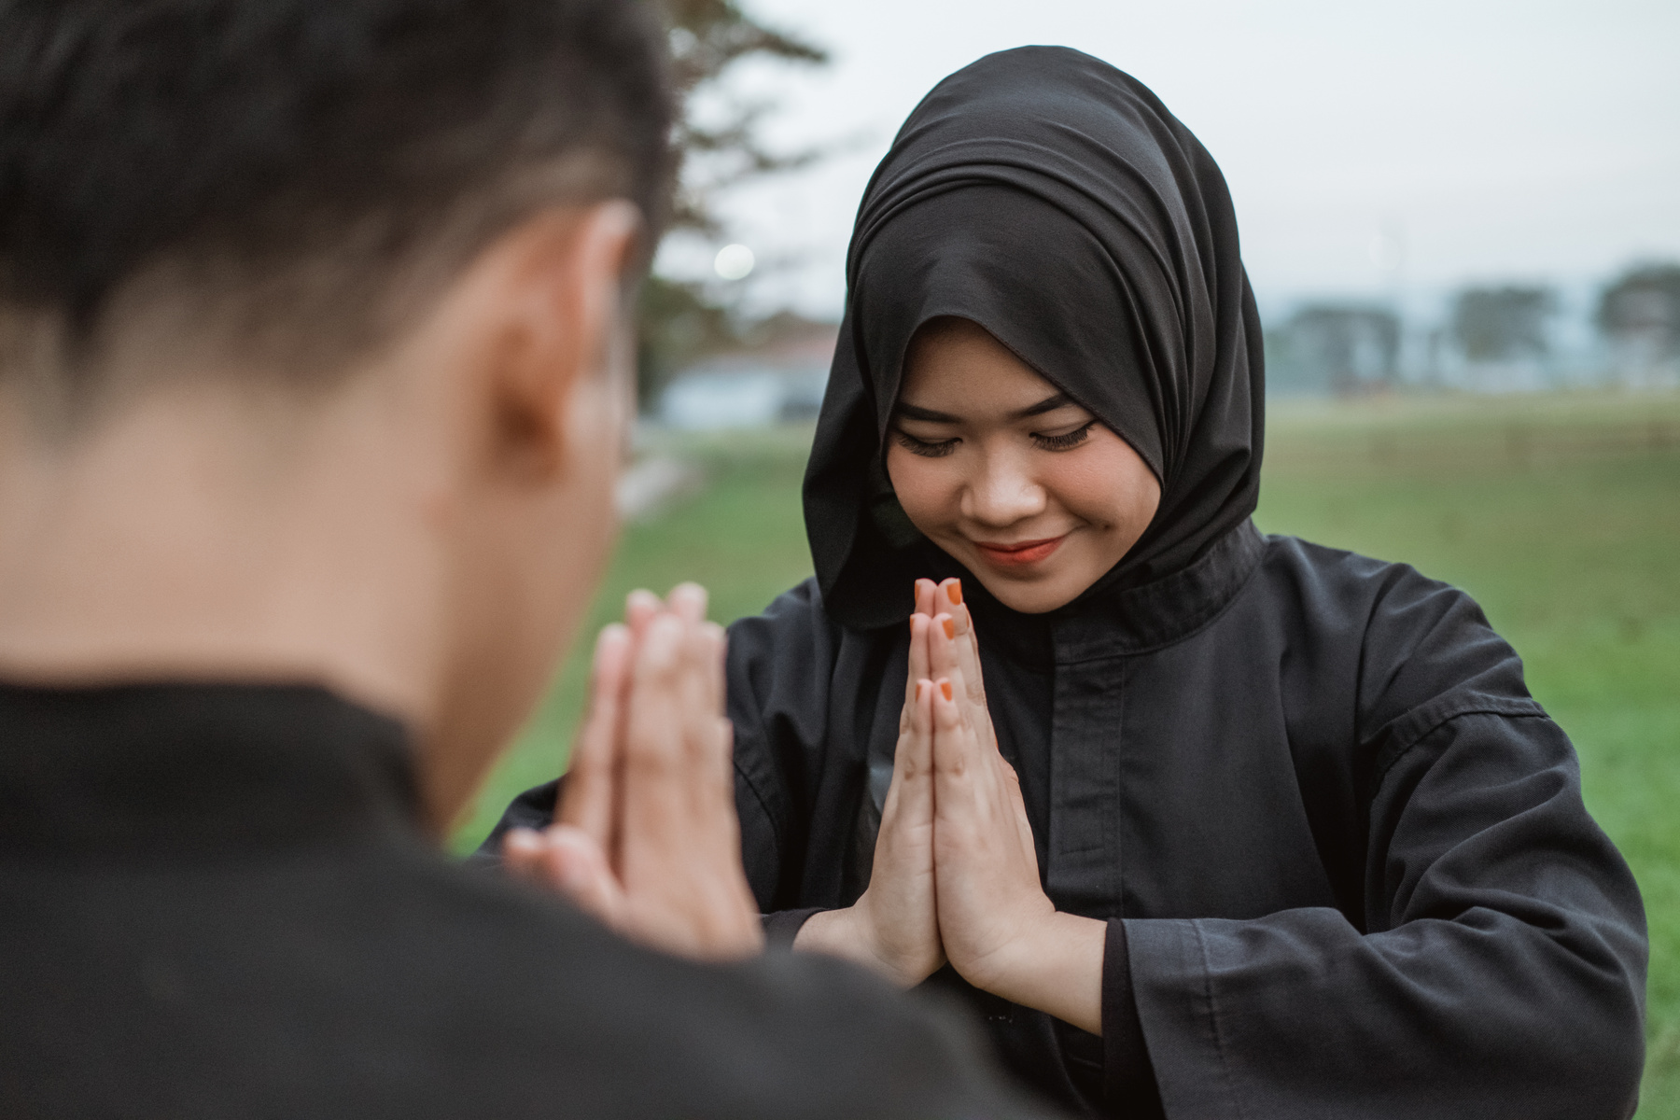
Don’ts:
1. Don’t attempt the Wai incorrectly: Thais won’t expect foreigners to get it right.
2. Don’t criticize the Royal Family: It’s illegal and considered deeply offensive.
3. Don’t touch someone’s head: The head is sacred in Thai culture.
4. Don’t point your feet at others: Feet are considered unclean.
5. Don’t step on Thai currency: It bears the King’s image, and stepping on it is highly disrespectful.
6. Don’t raise your voice in restaurants: Always be polite and avoid being loud.
7. Don’t use chopsticks unnecessarily: Fork and spoon are preferred for most meals.

Slide 6
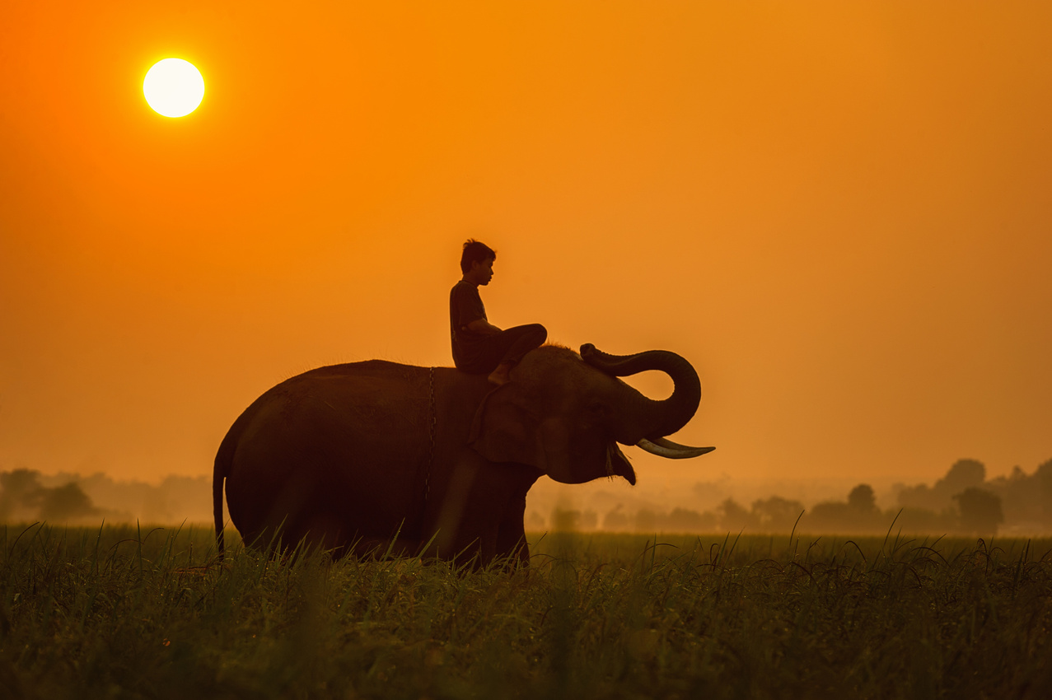
Event Information
1. Explore the Grand Palace & Wat Phra Kaew
- Visit Bangkok’s most iconic landmark, home to the Emerald Buddha, Thailand’s most revered religious artifact.
2. Wat Arun (Temple of Dawn)
- This riverside temple offers beautiful views, especially at sunset, and features stunning architectural details.
3. Take a Boat Ride Along the Chao Phraya River
- Explore the city from the water, passing temples, markets, and modern skyscrapers while experiencing Bangkok’s unique urban landscape.
4. Visit Wat Pho and See the Reclining Buddha
- Wat Pho is famous for its massive golden Reclining Buddha and is also home to Thailand’s first massage school. You can enjoy an authentic Thai massage here.
5. Shop at Chatuchak Weekend Market
- One of the largest markets in the world, offering everything from clothing and accessories to antiques, plants, and street food.
.
.

Slide 7
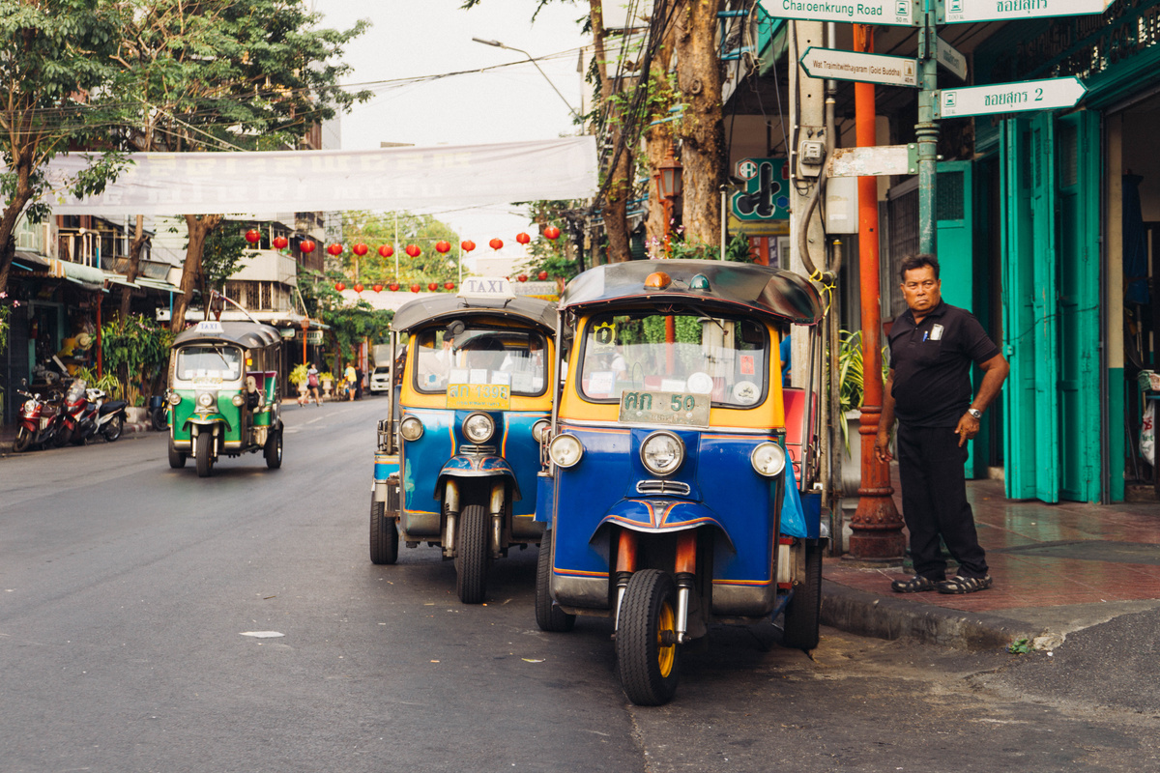
Event Information
6. Street Food Tour in Chinatown (Yaowarat)
- Dive into Bangkok’s legendary street food culture by trying local delicacies like Pad Thai, mango sticky rice, and grilled skewers in this vibrant neighborhood.
7. Enjoy a Rooftop Bar Experience
- Bangkok has a plethora of rooftop bars with stunning views of the city skyline. Sky Bar at Lebua State Tower or Octave Rooftop Lounge are great options.
8. Experience a Floating Market
- Visit markets like Damnoen Saduak or Amphawa, where vendors sell their goods from boats. It’s a glimpse into traditional Thai life along the waterways.
9. Visit Jim Thompson House
- A beautiful traditional Thai house and museum dedicated to Jim Thompson, an American businessman who revitalized the Thai silk industry.
10. Check Out Khao San Road
- Famous for its backpacker culture, this lively street is packed with bars, food stalls, and shops, offering a great atmosphere for nightlife and people-watching

Slide 8
Budget

Slide 9
Travel Itenerary

